Slide 1

Win/Loss Prediction in Major League Soccer using Deep Learning model
Team-11: <[Sean Tyson,
Ben Reed,
Daniel Gonzalez,
M A Moonem]>

Slide 2
Topic:
Win/Loss Prediction in Major League Soccer using Deep Learning model
Reasons behind the topic:
Our team decided on this project because our home city, Austin, Texas, recently got its first MLS soccer club.
Austin FC, a new member of the Western Conference, has had a hot start to the 2021 season.
We wanted to dig into the historic performance of rival clubs and develop a machine learning model to predict outcomes for our home team's first season.

Slide 3
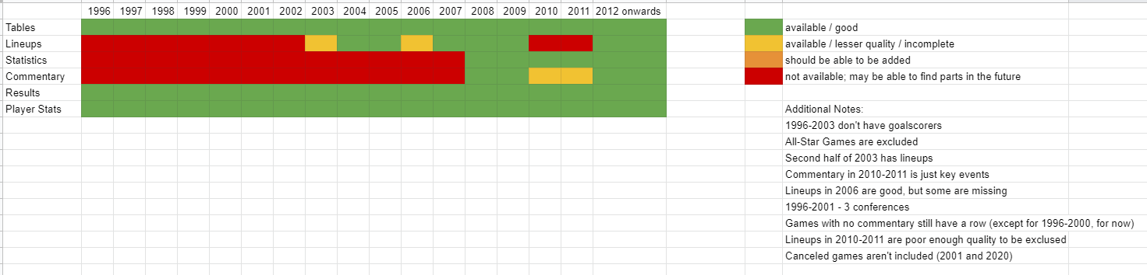
Data Source
Data Source is the Kaggle data, Major League Soccer Dataset - by Joseph Mohr, last updated 11th July, 2021; version 34. The weblink: https://www.kaggle.com/josephvm/major-league-soccer-dataset
This dataset contains player, game, event, and table data from Major League Soccer (MLS).
There is currently information on over 6000 matches and almost 420,000 events from those matches.
In the Kaggle webpage, this dataset is rated with a score of 8.8 for Data Usability which seems good.

Slide 4
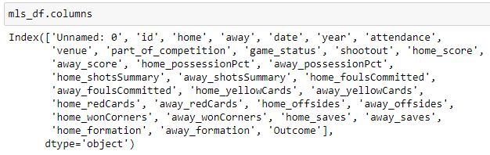
Finding answers from the data
The following figure shows the column headers which are essentially the FEATURES (X) and the last “outcome” column is the OUTCOME (y) for the Deep Learning Model.
As the headers say, we expect to relate a good prediction of outcome based on the feature columns.

Slide 5
Data Exploration
In the data exploration stage, each member worked on their own .csv file to understand the data content i.e., columns, empty or null values.
The key task in exploration was to understand most of the abbreviated column headers using Google search and match key columns (e.g., Team / CLub) with all 4 .csv files.
Deciding which columns seem insignificant in decision making and may be dropped.
Identified columns with data anomaly which needed to be cleaned.

Slide 6
Data Analysis
Updated column titles for clarity
Fixed Goal_Differential calculation errors
Removed all data prior to 2004 (due to most of the columns having null values)
Removed seemingly insignificant data column
Cleaned, renamed mismatching club names
Removed duplicate entries
Applied regex on a date column with anomaly in entry
Fixed Points column calculations
Reordered columns for clarity
Exported the cleaned .csv files to the project folder
These clean files are used in DB forming and ML processing phases

Slide 7
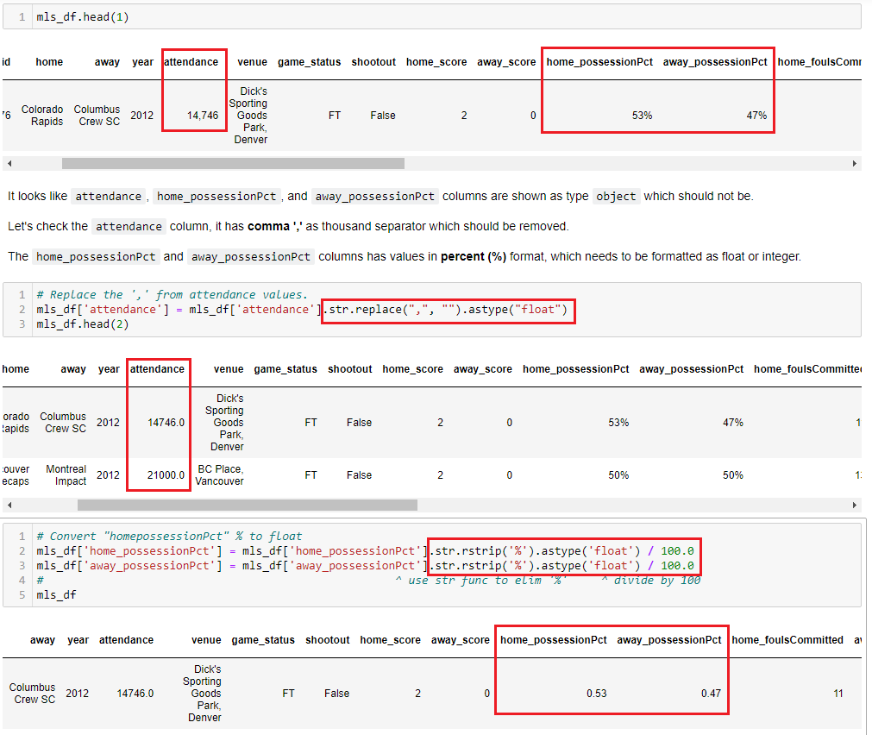
Data
Cleaning

Slide 8
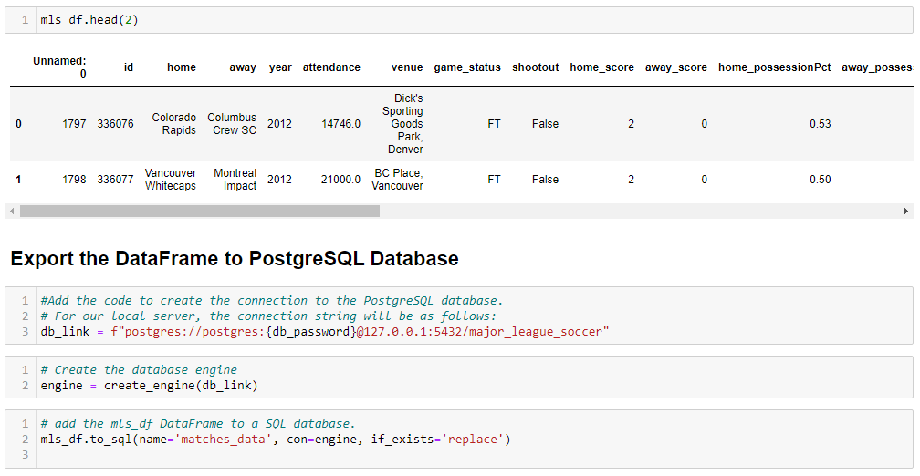
Exporting data From DataFrame to SQL

Slide 9
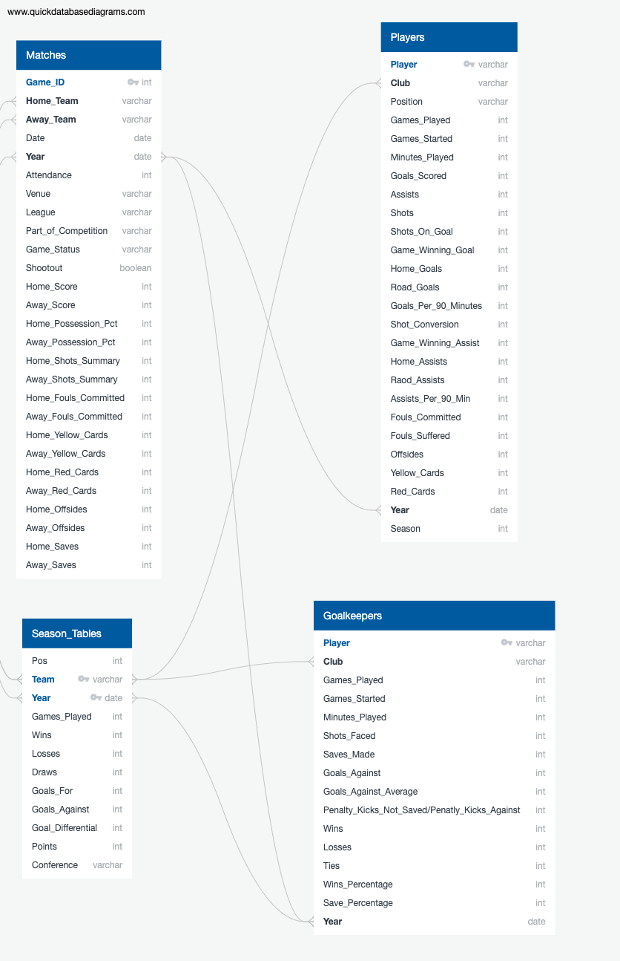
Creating an ERD for SQL Database

Slide 10
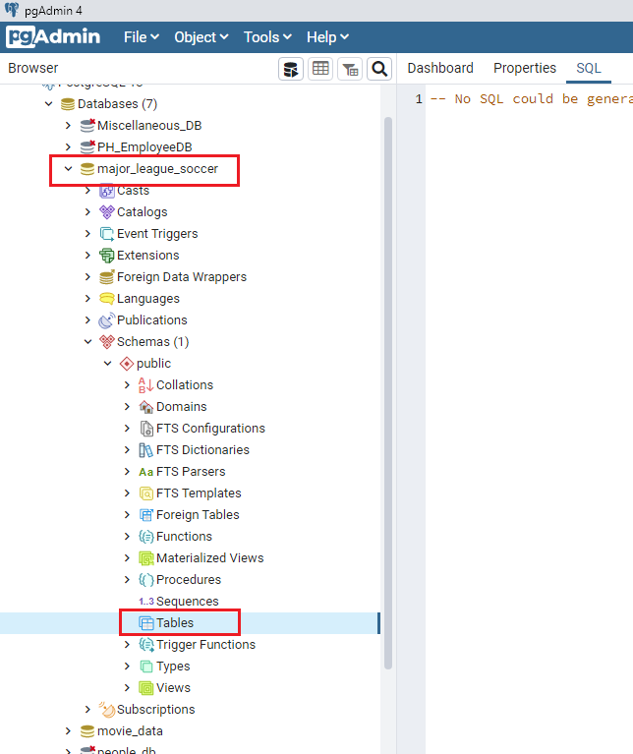
Creating a Database in PostgreSQL
Creating an empty database named “major_league_soccer”

Slide 11
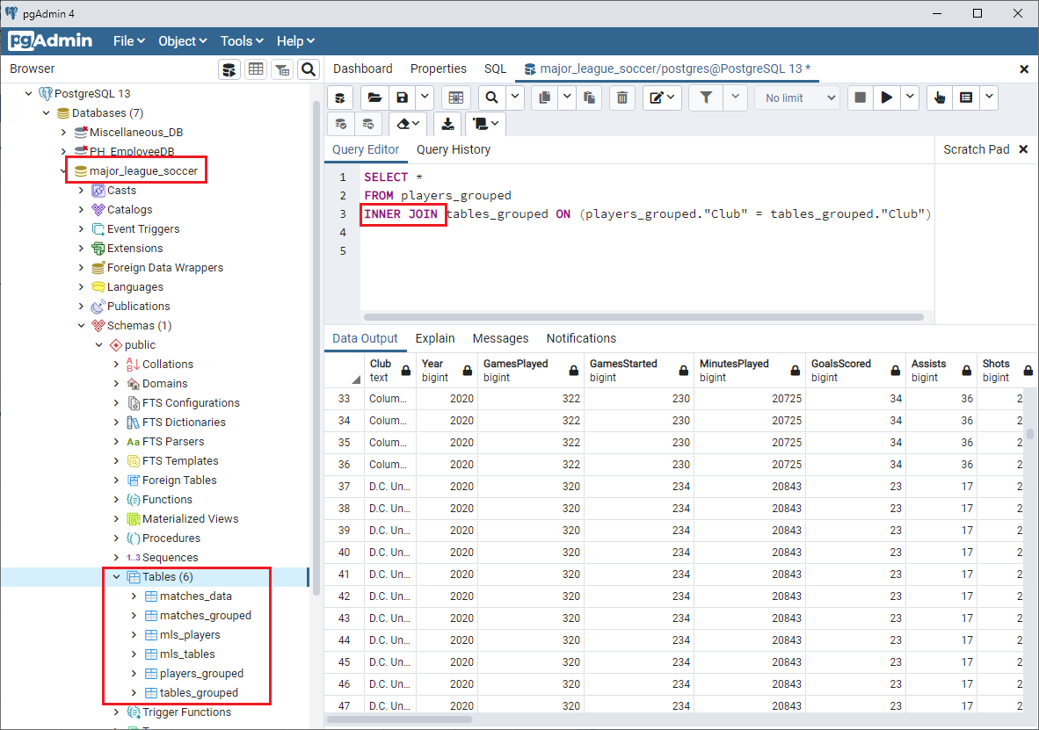
Database in PostgreSQL
Created a database “major_league_soccer” in PgAdmin
Exported 6 cleaned DataFrames to SQL tables
2 tables are joined using SQL Query

Slide 12
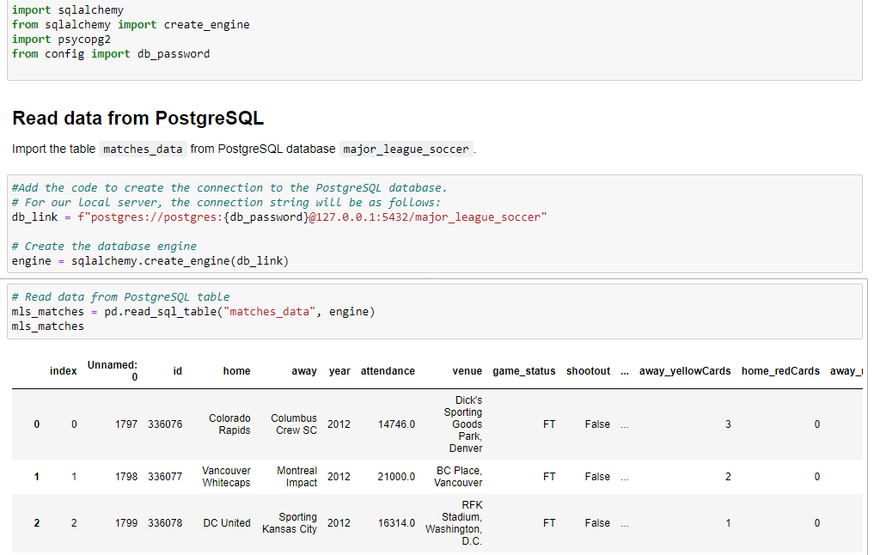
Reading data from SQL Database
For Deep Learning preprocessing, data tables are imported from the SQL database

Slide 13
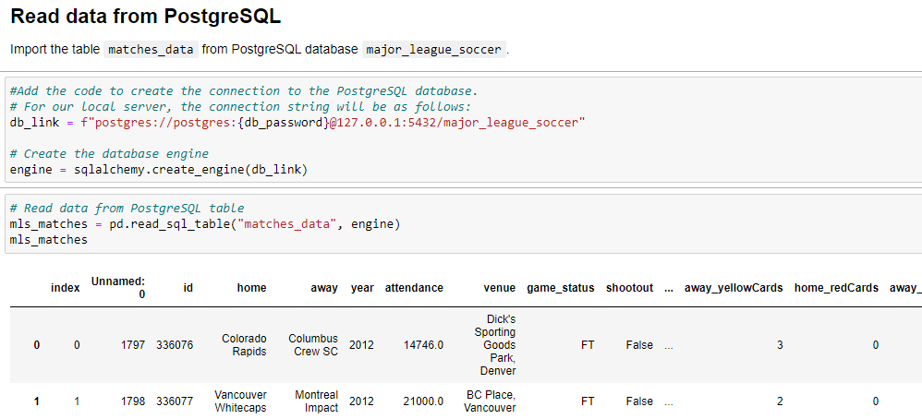
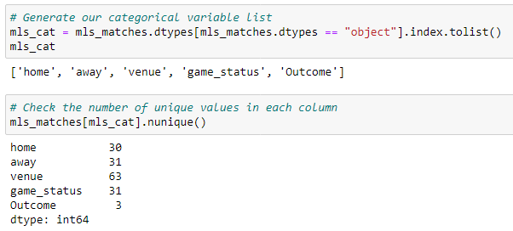
Deep Learning Model
Read data from SQL database:
Check categorical variables for OneHotEncoding:

Slide 14
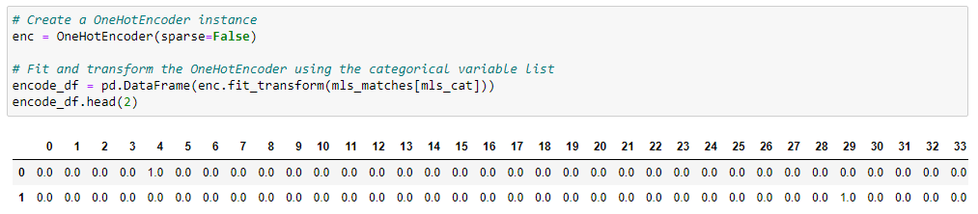
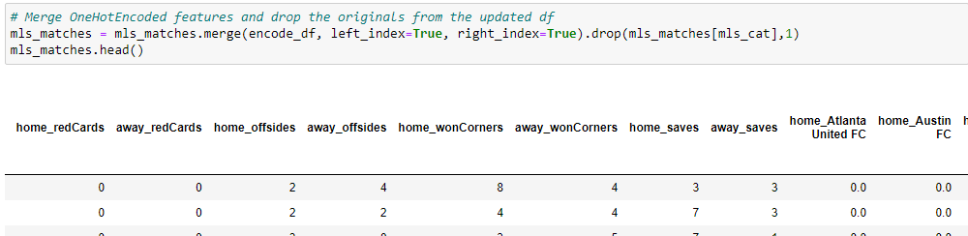
Deep Learning Model (continued)
3. OneHotEncoder:
4. Merging encode_df with original mls_matches:

Slide 15
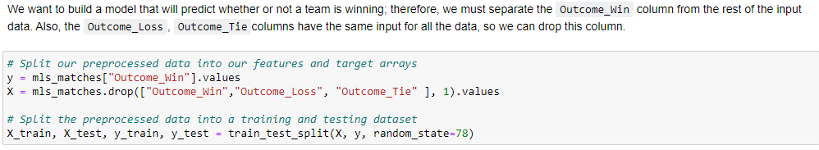
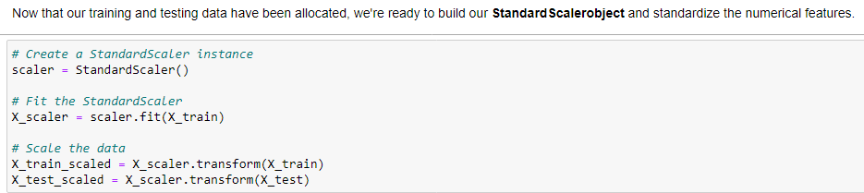
Deep Learning Model (continued)
5. Define features and output:
6. Scaling training and testing dataset:

Slide 16
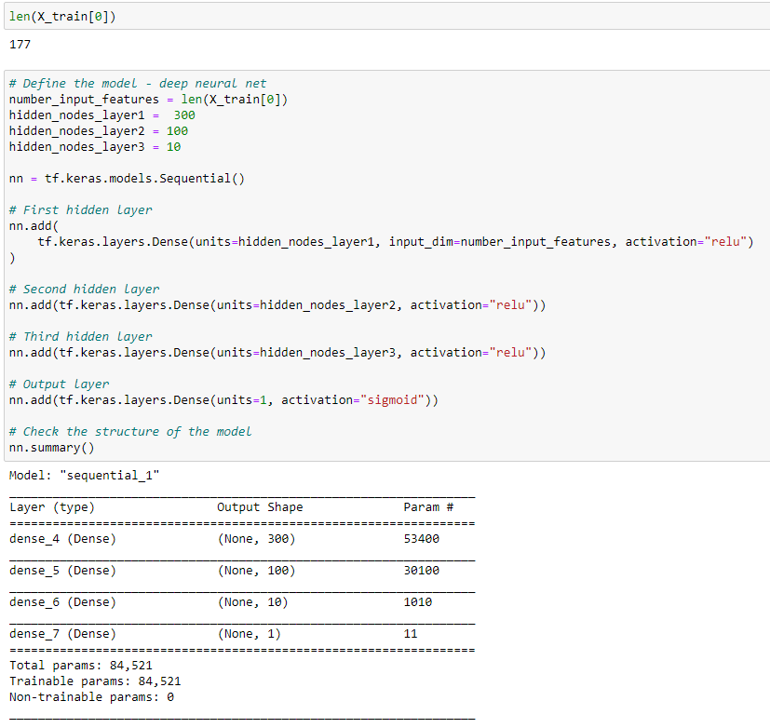
Deep Learning Model (continued)
7. Define neural network:

Slide 17
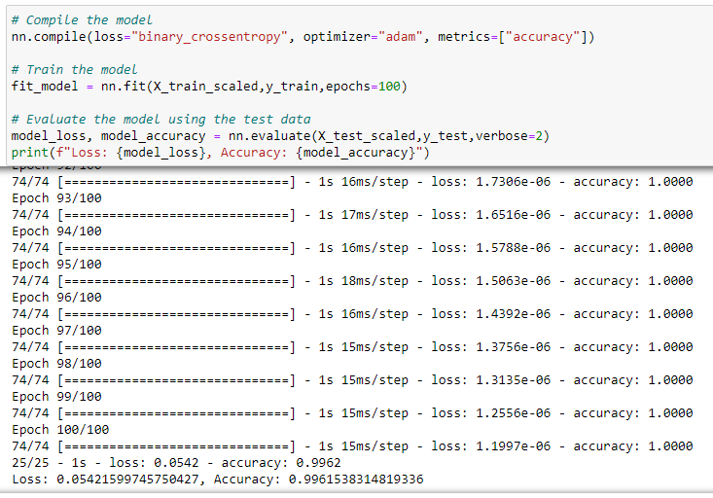
Deep Learning Model (continued)
8. Compile and Evaluate the neural network model:
Finding:
A team outcome for “Win” in a game is 99% accurate
Observation:
The accuracy of the model seems “too good to be true”.
We’ve checked back again and made sure we followed all the steps we’ve learned in Module-19.

Slide 18
Thank You

